Slide 1
PH160 Laboratory session 2
Name : Snehal Keshav Nalawade
Student ID : 202151160

Slide 2
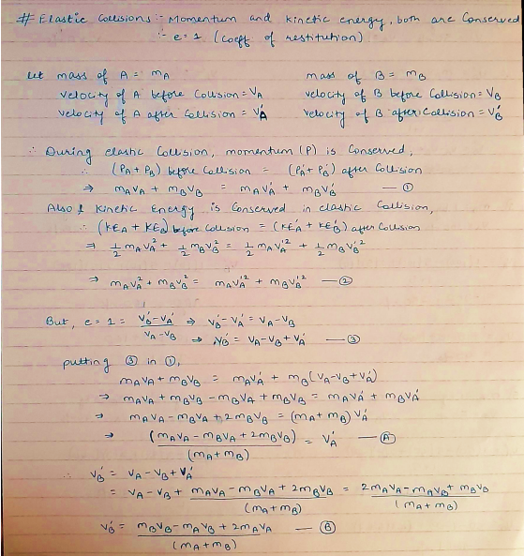
Aim : To demonstrate Elastic and Inelastic collisions.
Theory :
A) Elastic Collision :

Slide 3
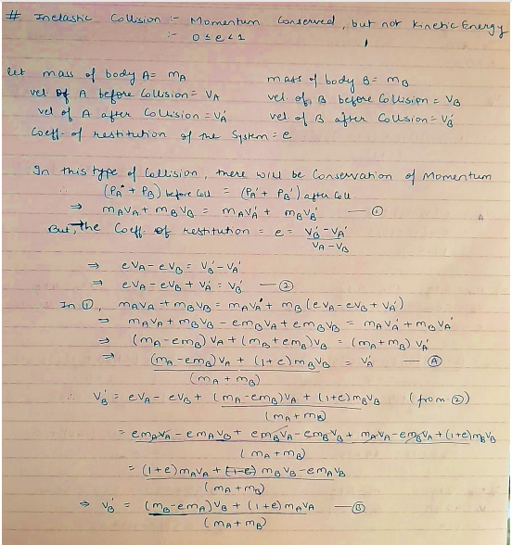
B) Inelastic Collision :

Slide 4
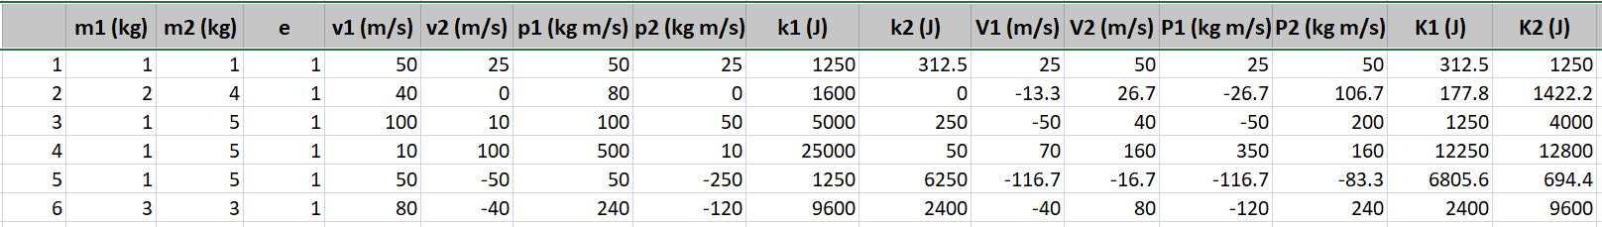
Observation :
Let, mass of body A = m1 mass of body B = m2
initial(before collision) velocity of A = v1 initial velocity of B = v2
initial momentum of A = p1 initial momentum of B = p2
initial kinetic energy of A = k1 initial kinetic energy of B = k2
final(after collision) velocity of A = V1 final velocity of B= V2
final momentum of A = P1 final momentum of B = P2
final kinetic energy of A = K1 final kinetic energy of B = K2
Coefficient of restitution = e
A) Elastic Collision :

Slide 5
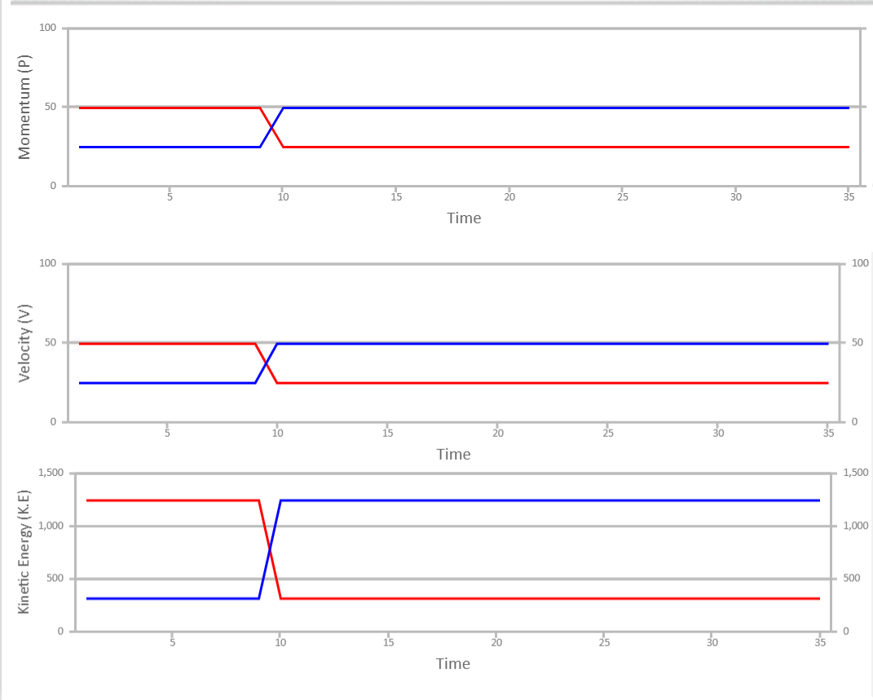
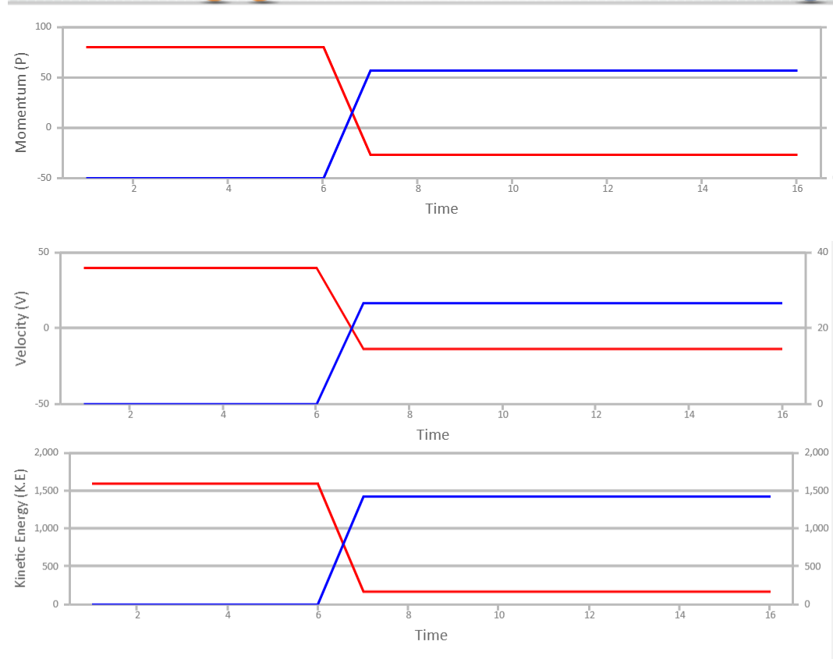
1)
2)

Slide 6
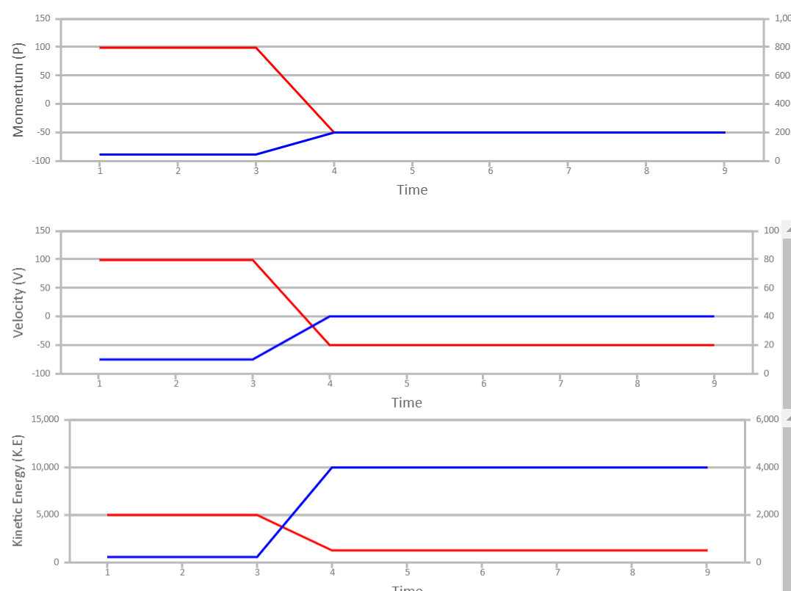
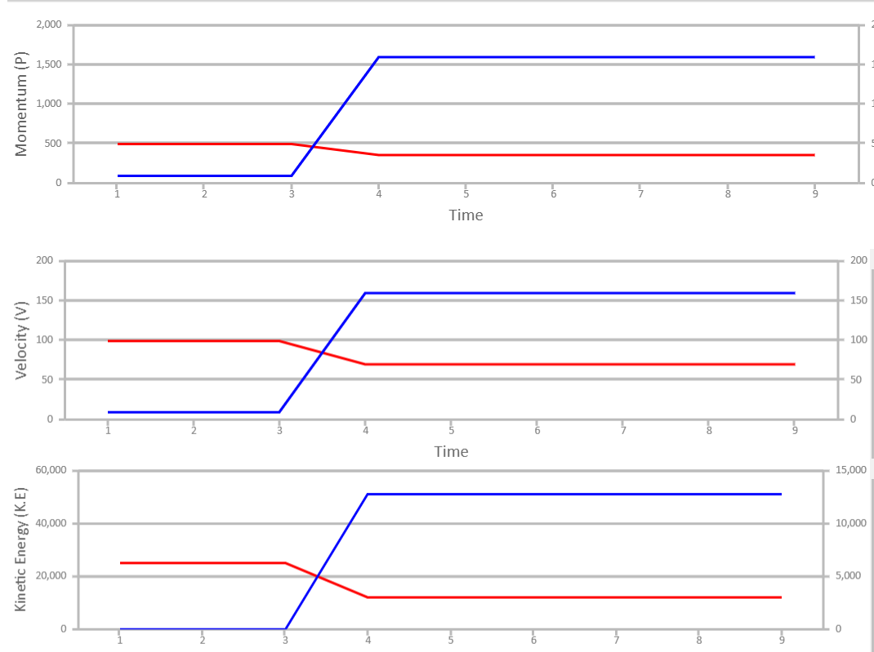
3)
4)

Slide 7
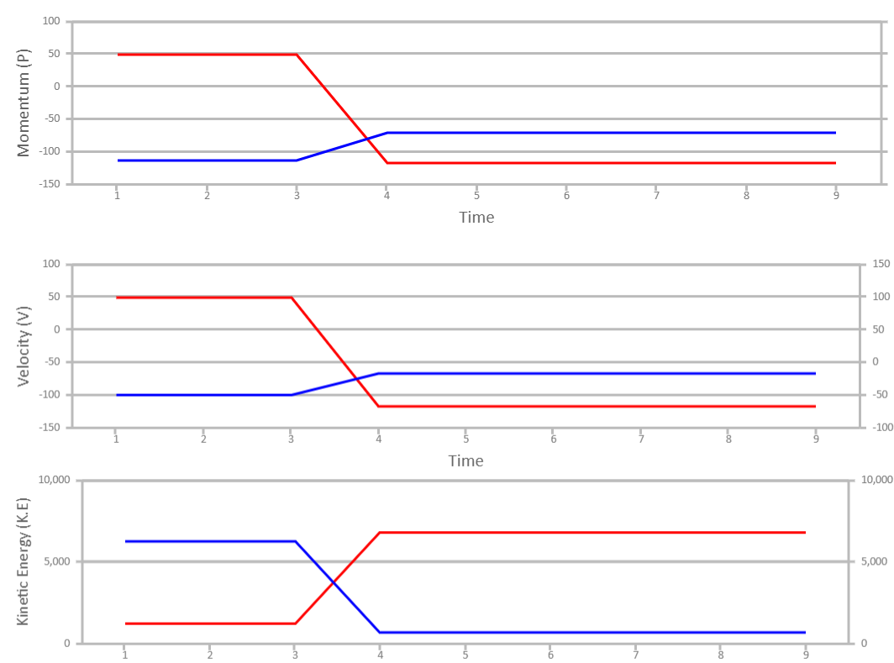
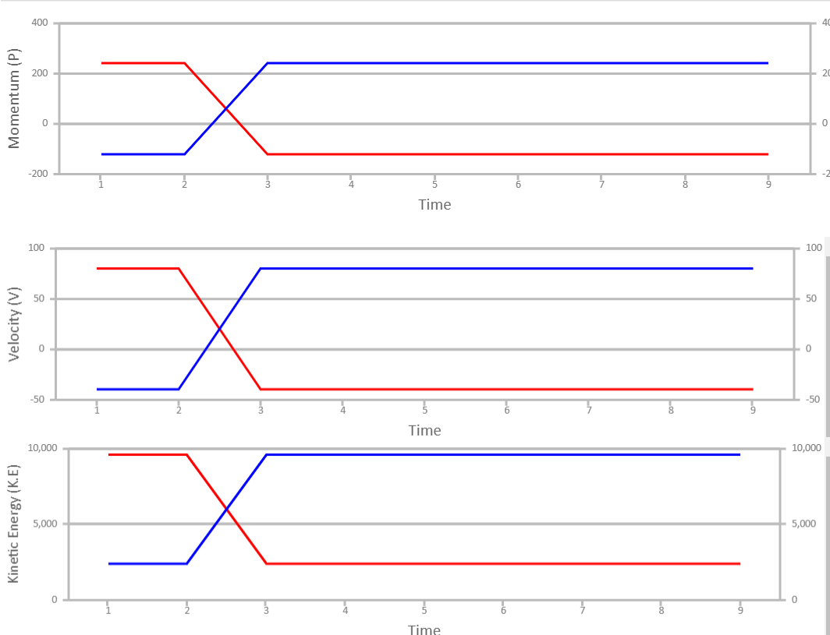
5)
6)

Slide 8
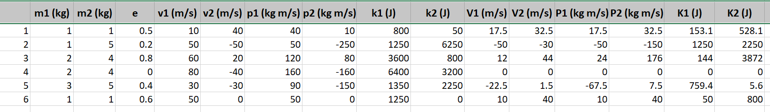
B) Inelastic Collision :

Slide 9
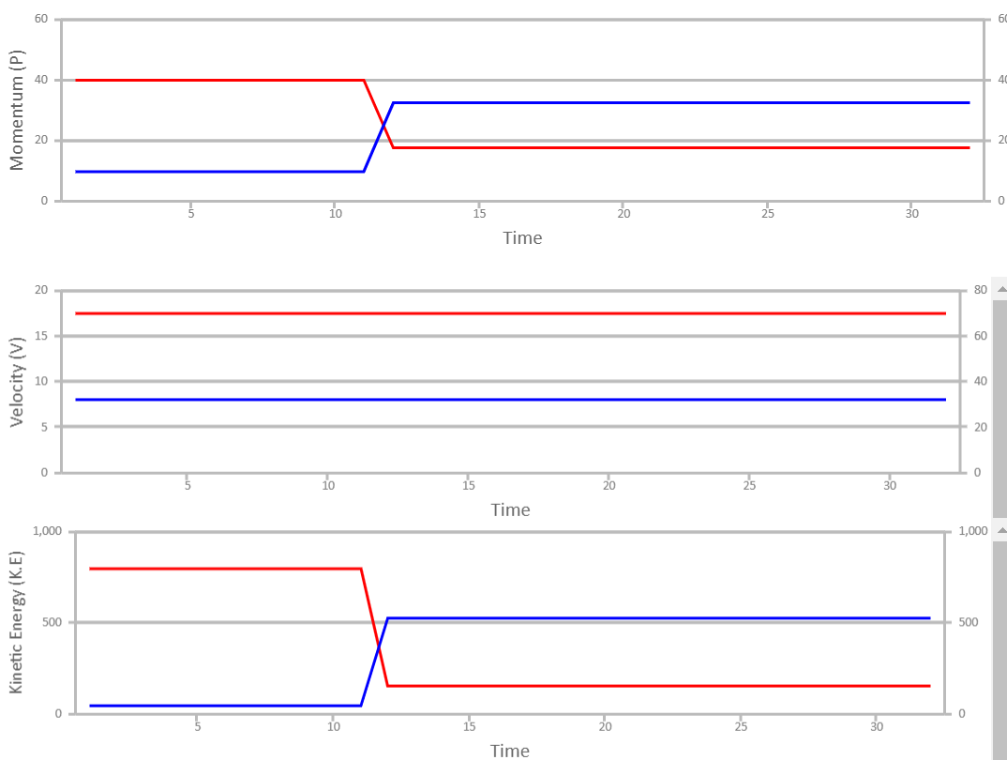
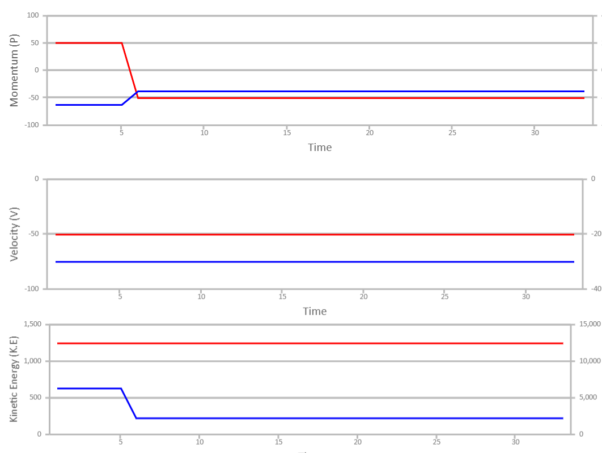
1)
2)

Slide 10
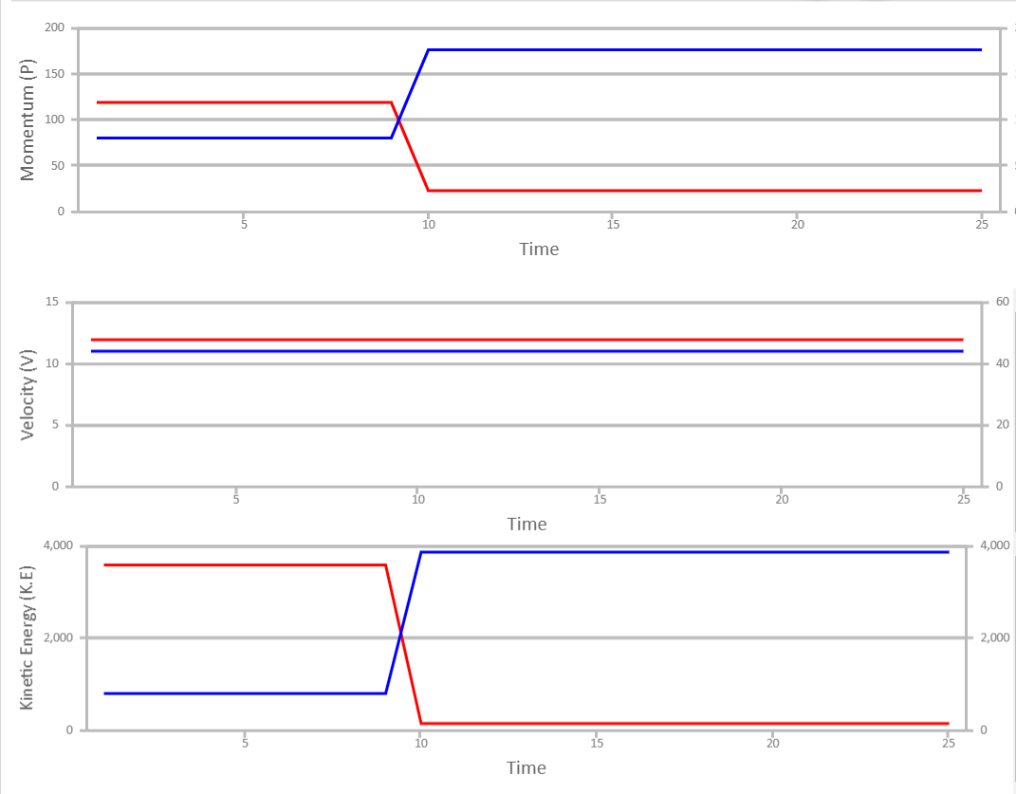
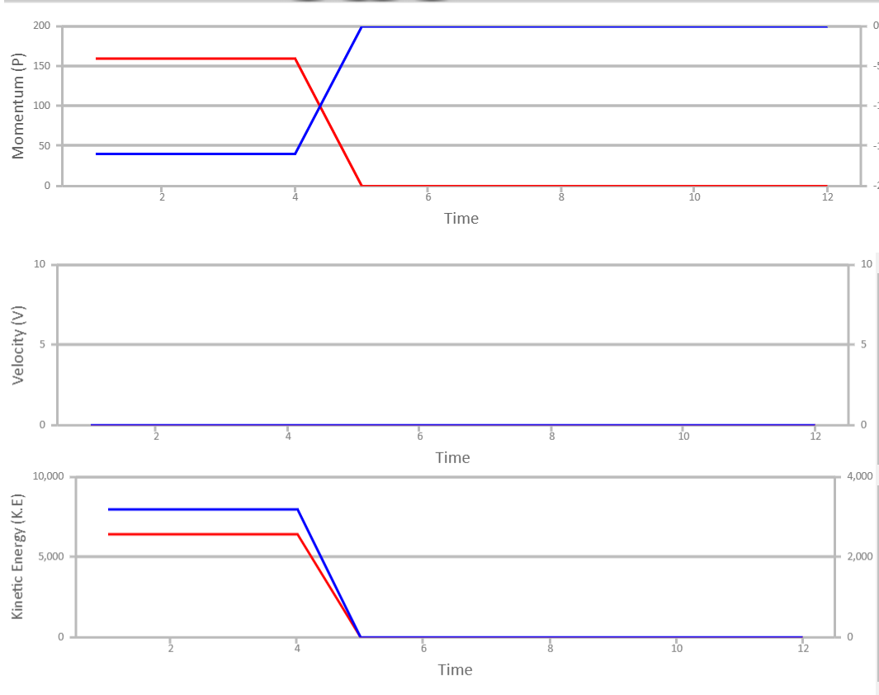
3)
4)

Slide 11
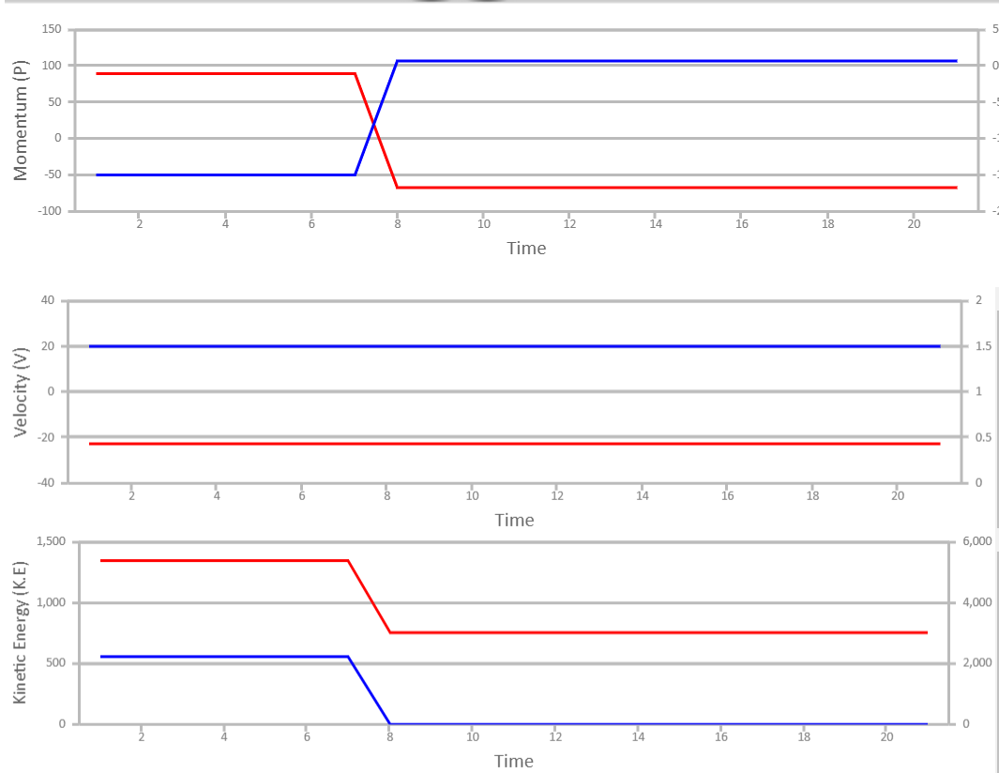
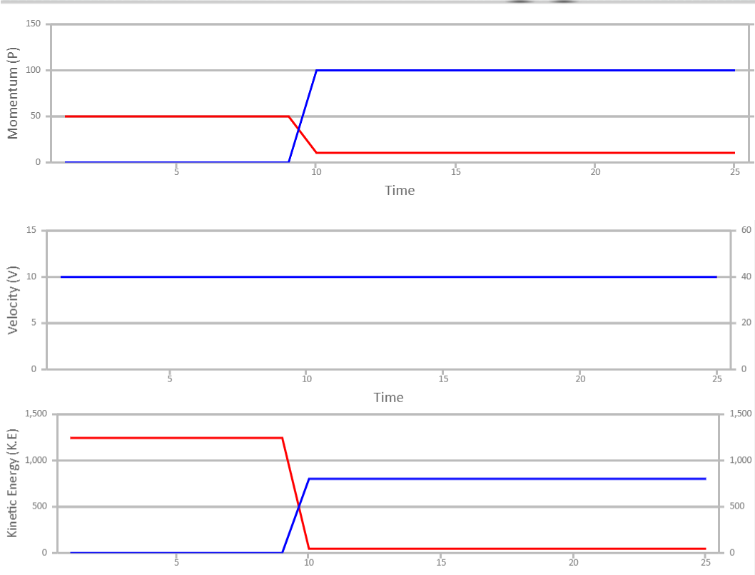
5)
6)

Slide 12
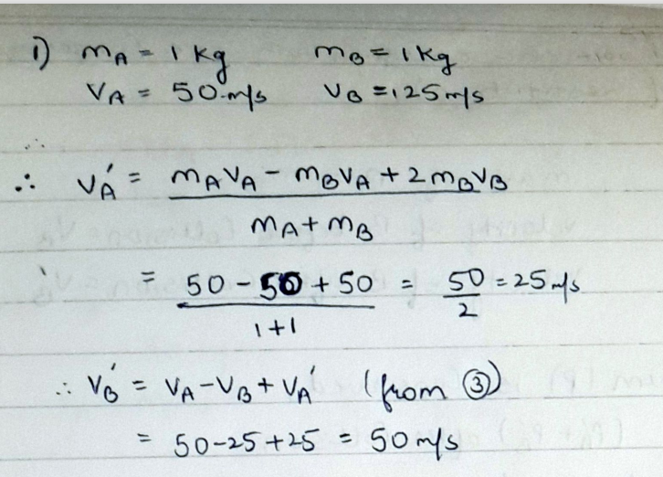
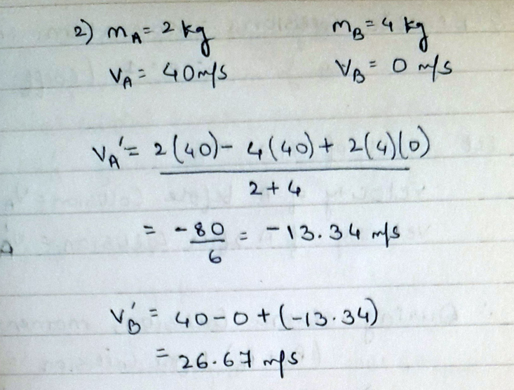
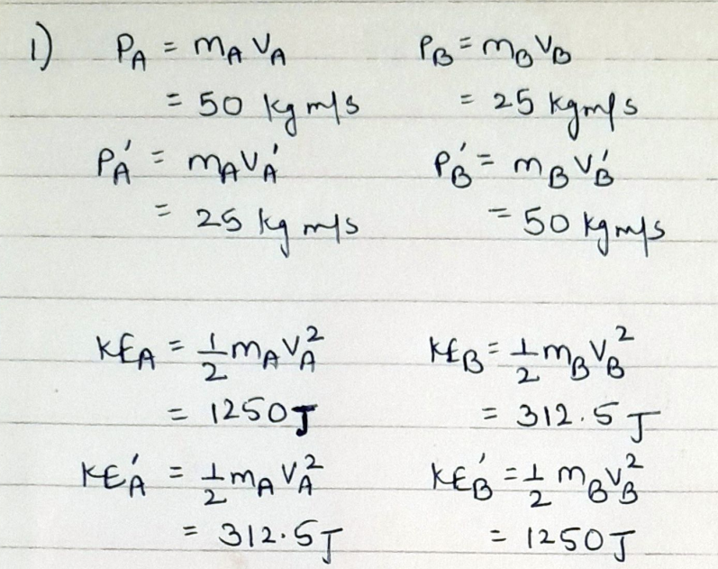
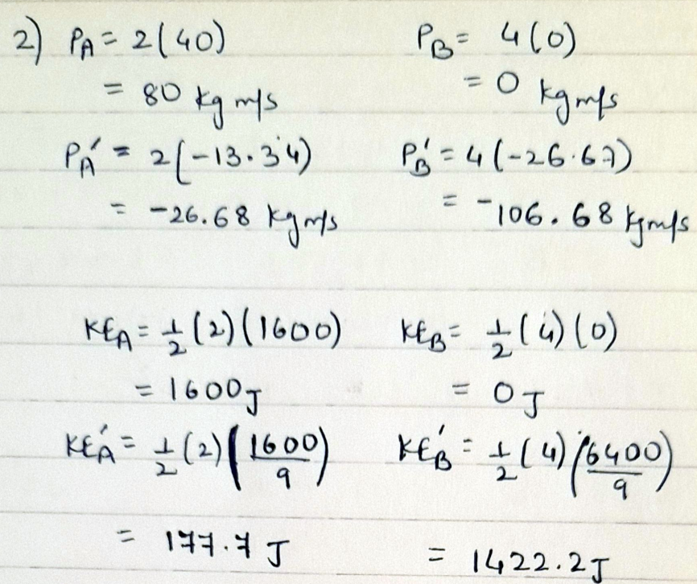
Calculation :
A) Elastic Collision :
2)
1)

Slide 13
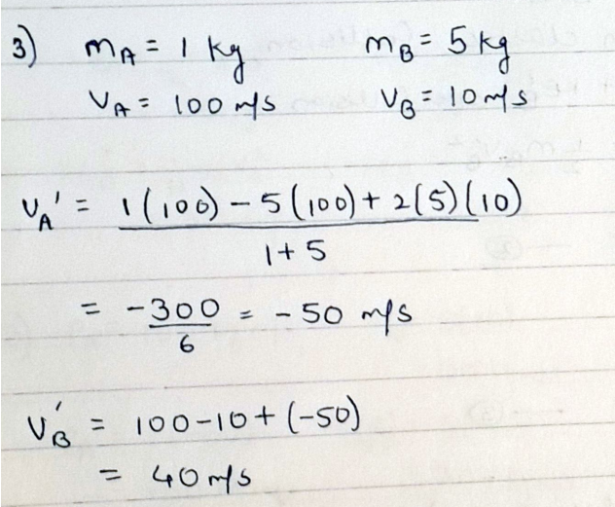
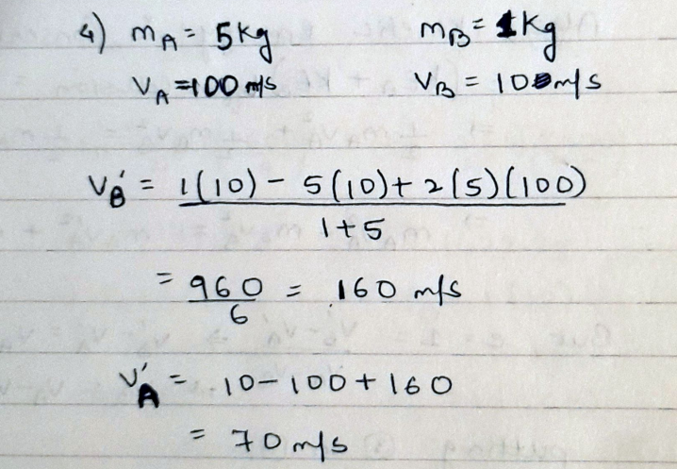
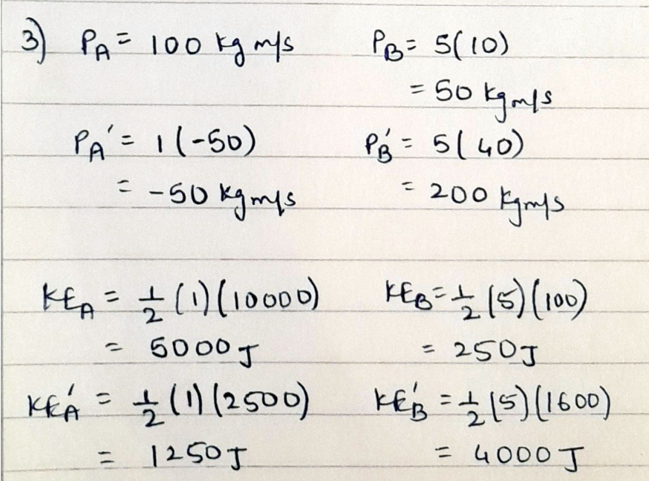
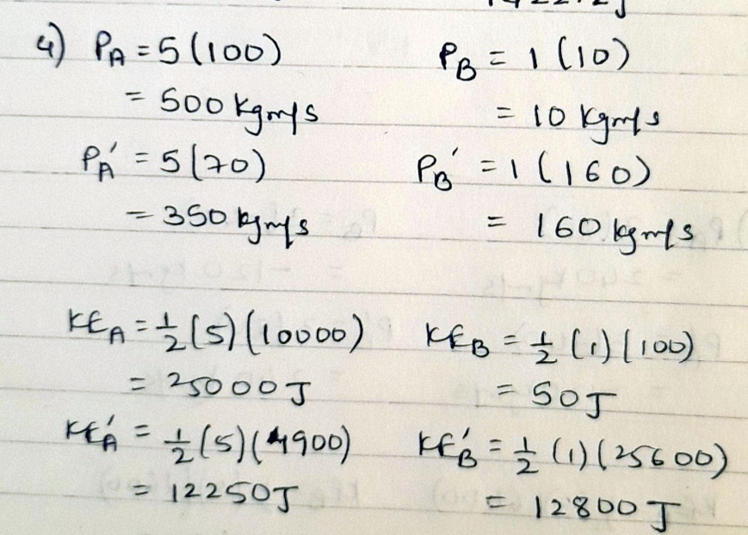
3)
4)

Slide 14
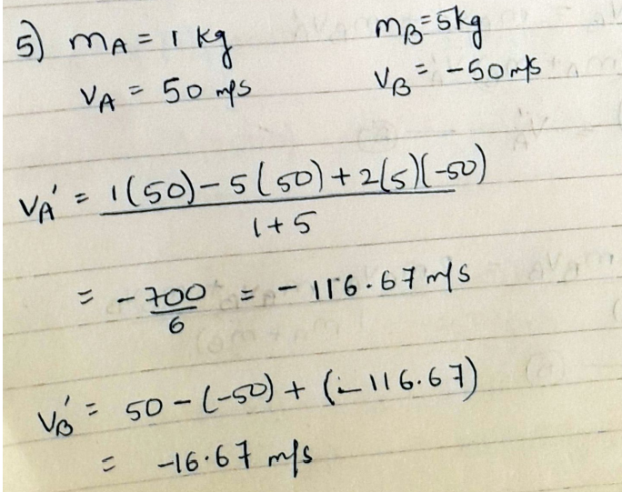
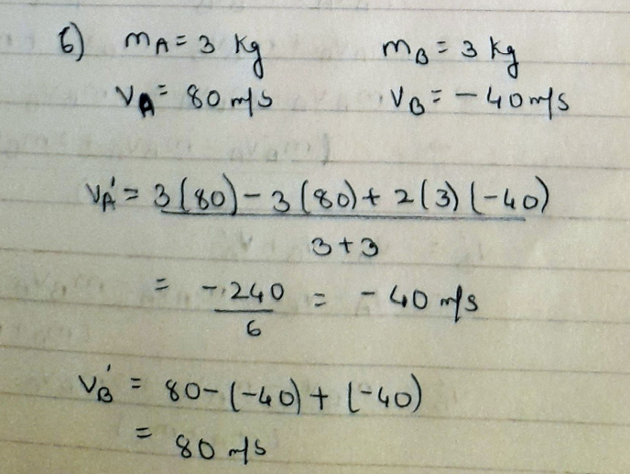
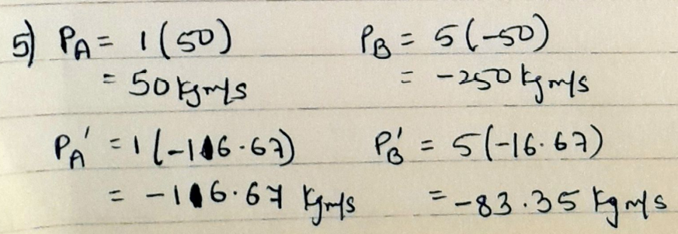
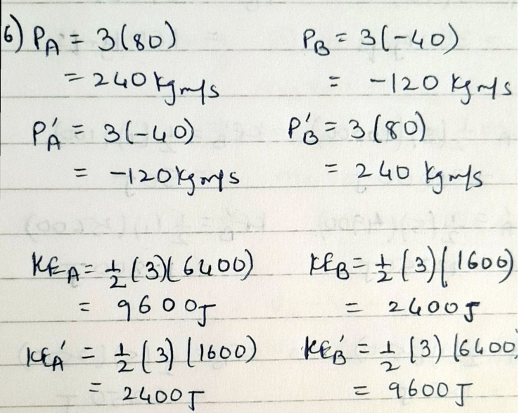
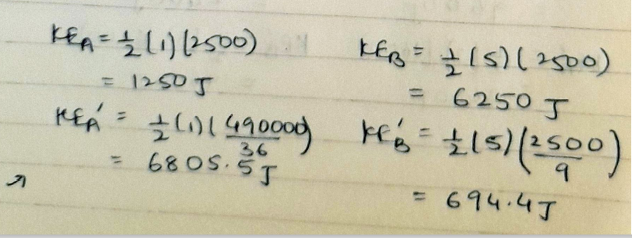
5)
6)

Slide 15
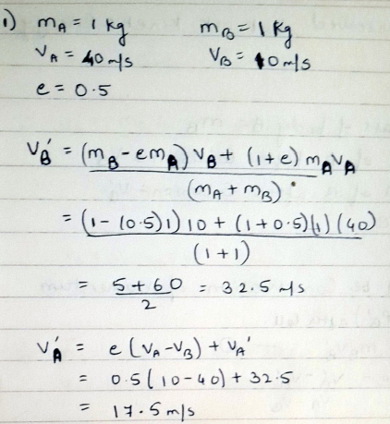
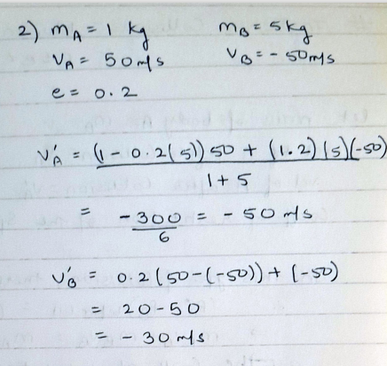
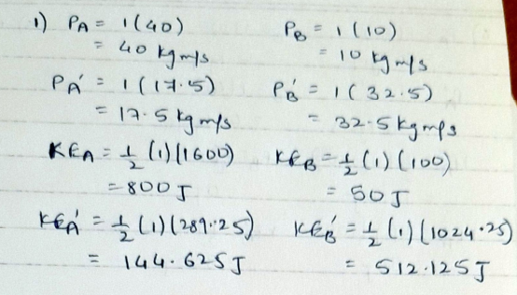
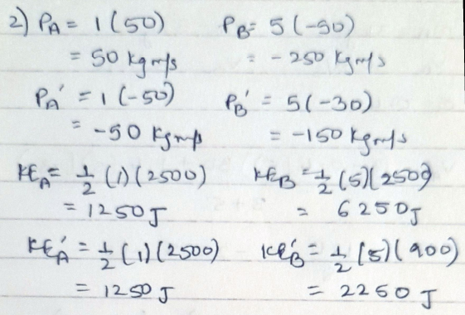
B) Inelastic Collision :
1)
2)

Slide 16
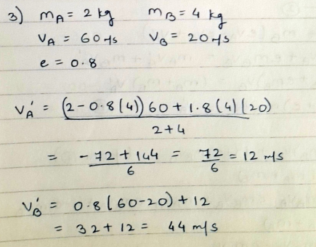
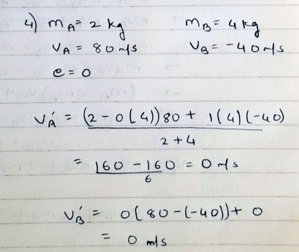
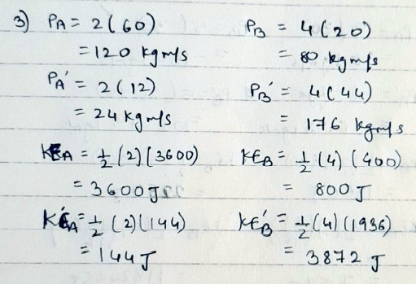
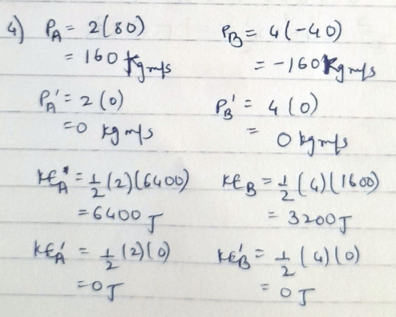
3)
4)

Slide 17
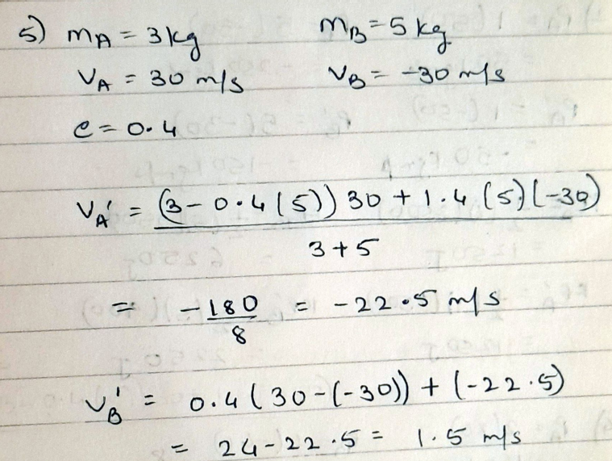
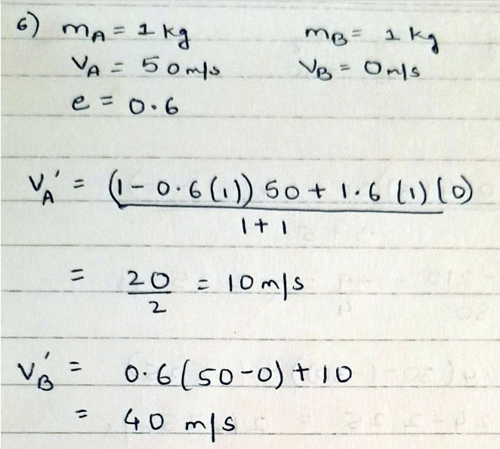
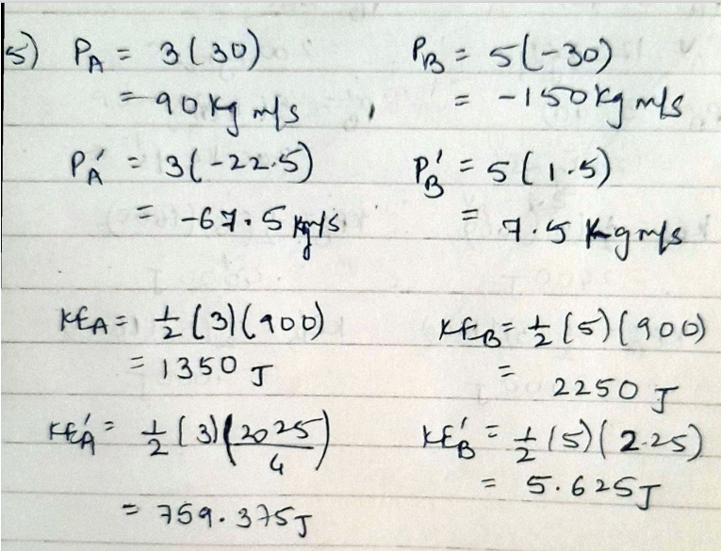
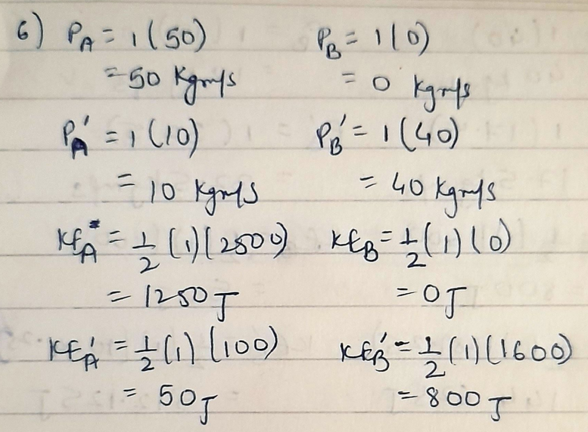
5)
6)

Slide 18
Error in Result : Since the experiment is conducted virtually using a simulator, therefore no error is observed. The slight variations seen between the observed and calculated values of velocity, momentum or kinetic energy, as seen in some cases are just because the simulator has given values rounded off to lower precision.
Result Analysis : the values of final velocities, momentum and kinetic energies of the two bodies as observed using the simulator are equal to the values calculated by applying the conservation of linear momentum and using the relation of the coefficient of restitution with the initial and final velocities of both the bodies (and by applying the conservation of kinetic energy in case of elastic collisions too). This shows that all these conditions and relations considered in case of elastic and inelastic collisions hold true.

Slide 19
Thank you

